Slide 1
EDUCATION AND COMPETENCE
Satakunta

Slide 2
1
English-Language Education
Swedish-Language Education
Upper Secondary Education
Vocational Education
Higher Education
Satakunta University of Applied Sciences
Key Figures
University Consortium of Pori
The Educational Health Center in Pori
Rauma Campus of University of Turku
Diaconia University of Applied Sciences
Pori Brigade
5
2
3
6
4

Slide 3
English-Language Education
EARLY CHILDHOOD
Pilke Daycare
Pori English Playschool
PRESCHOOL
English Preschool at Viikari
COMPREHENSIVE
Grades 1-6: Cygnaeus School
Grades 7-9: Porin suomalainen yhteislyseo (PSYL) School
UPPER SECONDARY
Pori Lyseo Upper Secondary School
HIGHER
Satakunta University of Applied Sciences SAMK
In Pori, there are possibilities for English-language education at all levels.
Notes:
In Finnish:
Early childhood/Varhaiskasvatus:
https://www.pori.fi/kasvatus-ja-koulutus/varhaiskasvatus/yksityinen-varhaiskasvatus
Preschool/Esiopetus:
https://www.pori.fi/kasvatus-ja-koulutus/varhaiskasvatus/esiopetus/englanninkielinen-esiopetus
Comprehensive/Perusopetus:
https://www.pori.fi/painotettuopetus
https://peda.net/pori/perusopetus/koulujen-kotisivut/pl1/cygnaeuksenkoulu/opetus/el
https://peda.net/pori/perusopetus/koulujen-kotisivut/pl7/psyl/opetus/bto3
Upper secondary/Toinen aste:
https://www.pori.fi/kasvatus-ja-koulutus/lukiot/porin-lukiot
https://www.pori.fi/kasvatus-ja-koulutus/lukiot/porin-lukiot-ja-erityislinjat/porin-lyseon-lukio/erityislinjat
Higher/Korkeakoulutus:
https://www.samk.fi/

Slide 4
Swedish-Language Education
Björneborgs svenska samskola, founded in 1892, offers Swedish-language early childhood education, basic comprehensive education and upper secondary education in Pori.
Notes:
http://www.bjss.fi/

Slide 5
Upper Secondary Education
The upper secondary schools in Satakunta offer plenty of opportunities for their students. Some offer specific diplomas, others specialize in for example internationality.
17 upper secondary schools
Notes:
Links:
>> Björneborgs svenska samskola, Pori >> Eurajoki Upper Secondary School >> Eura Upper Secondary School >> Harjavalta Upper Secondary School >> Honkajoki Upper Secondary School >> Kankaanpää Secondary School >> Kokemäki Upper Secondary School >> Lauttakylä Upper Secondary School, Huittinen >> Merikarvia Upper Secondary School >> Nakkila Upper Secondary School >> Pomarkku Upper Secondary School >> Pori Upper Secondary School for Adults >> Upper Secondary School of Pori Lyceum >> Upper Secondary School of Pori's Finnish Co-ed Lyceum >> Rauma Upper Secondary School >> Upper Secondary School of the Säkylä Region >> Ulvila Upper Secondary School

Slide 6
Vocational Education
Finnish Aviation Academy
Huittinen Vocational and Business College
Kankaanpää Institute
Palmgren Conservatory
Sataedu
WinNova
There are 6 vocational education institutions in Satakunta.
The largest are Sataedu and WinNova.

Slide 7
SATAEDU
5000 students
10 locations
WINNOVA
6000 students
5 locations
Notes:
https://sataedu.fi/
https://www.winnova.fi/

Slide 8
HUITTINEN VOCATIONAL AND BUSINESS COLLEGE
500 students
2 locations
KANKAANPÄÄ INSTITUTE
Education since 1909
Well-known for its handicraft and interior design studies
PALMGREN CONSERVATORY
Located in Pori, Palmgren is a music school that offers education from early childhood to vocational studies
FINNISH AVIATION ACADEMY
Provides professional pilot training in Pori
100 students
Notes:
Huittinen Vocational and Business College:
https://sasky.fi/oppilaitokset/huittisten-ammatti-ja-yrittajaopisto/
Kankaanpää Institute
https://www.kankaanpaanopisto.fi/
Palmgren:
https://www.pori.fi/palmgren-konservatorio/esittely
Finnish Aviation Academy:
http://www.finaa.fi/
http://www.finaa.fi/fi/koulutus/ammattilentajan-opinnot/ammattilentaja--atpl.html
http://www.finaa.fi/fi/koulutus/presentaatio-17-10--ja-23-10-2019.html
https://ls24.fi/uutiset/suomen-ilmailuopisto-jatkaa-toimintaansa-porissa

Slide 9
Higher Education
4 higher education institutions
10 000 students
1500 new students each year
Notes:
http://www.satakunta.fi/en/four-higher-education-institutions

Slide 10
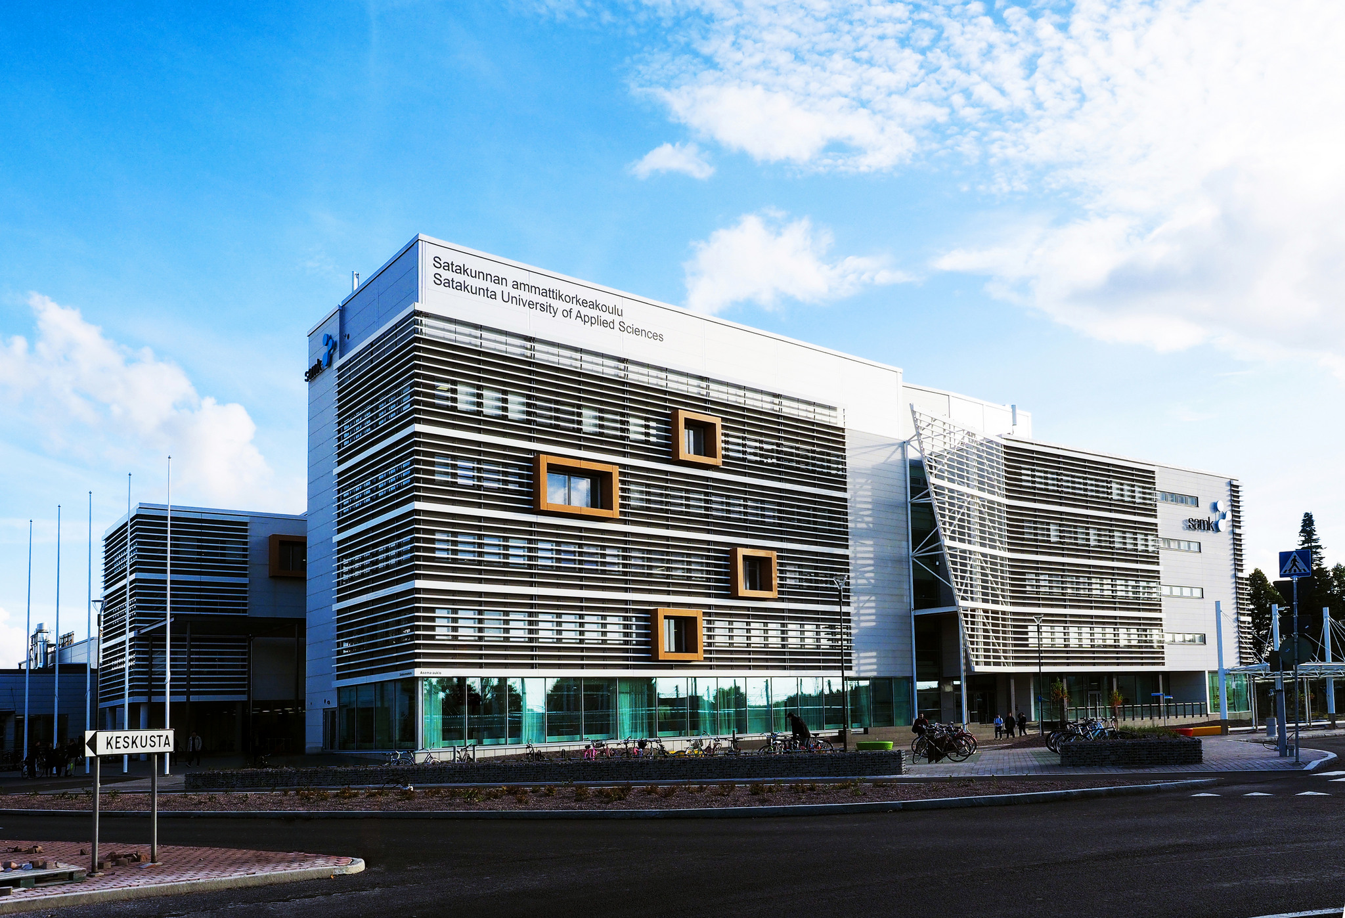
Satakunta University of Applied Sciences SAMK
SAMK is a multidisciplinary and internationally oriented university with about 6,000 students and 400 employees.
SAMK offers several bachelor’s and master’s degree programmes both in English and in Finnish.
Examples of English-language programmes include
Bachelor’s: Artificial Intelligence, Logistics, Sea Captain
Master’s: Business Management and Entrepreneurship, Welfare Technology
SAMK / Veera Korhonen
SAMK / Veera Korhonen
Notes:
https://www.samk.fi/en/
https://www.samk.fi/en/about-samk-2/

Slide 11
2019
SAMK – Key Figures
39
programmes
4
locations:
Pori, Rauma, Huittinen & Kankaanpää
Notes:
https://www.samk.fi/en/about-samk-2/

Slide 12
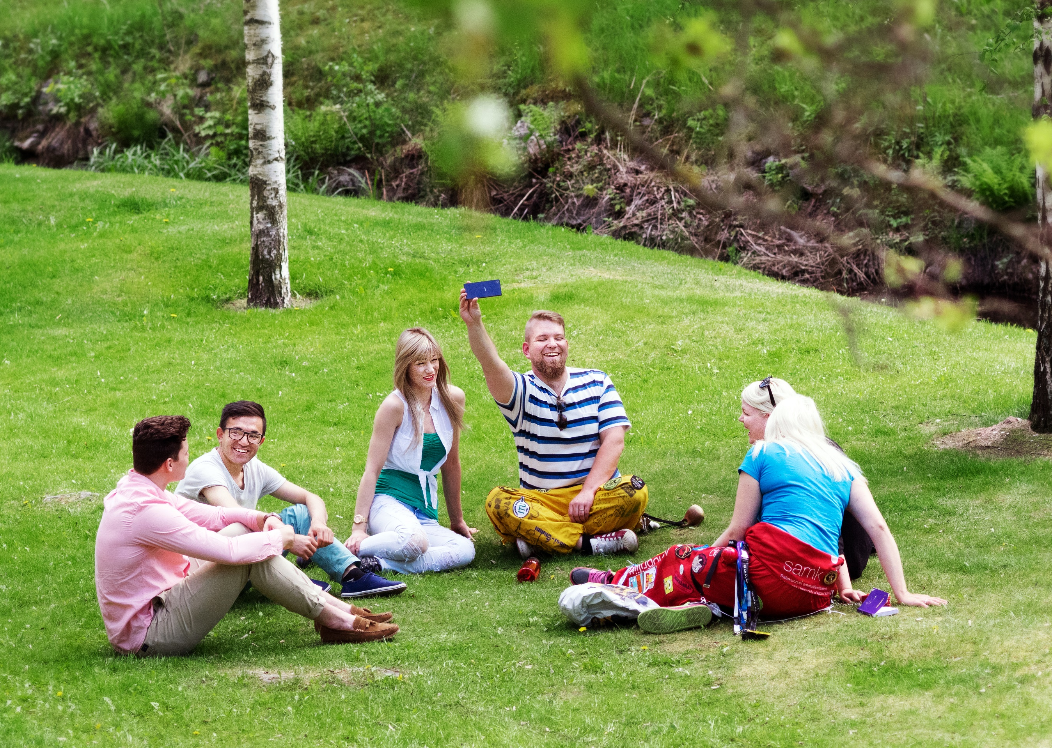
60 nationalities
130 international exchange students
150 SAMK students attending an exchange program abroad
200 international partner universities
SAMK / Veera Korhonen
Notes:
https://www.samk.fi/en/about-samk-2/

Slide 13
University Consortium of Pori
2 universities
1400 students
150 experts
There are two universities that offer teaching and conduct research at the University Consortium of Pori.
Tampere University – technology, social sciences
University of Turku – business & economics, cultural studies, maritime studies, medicine
University Consortium of Pori / Veera Korhonen
Notes:
https://ucpori.fi/en-gb

Slide 14
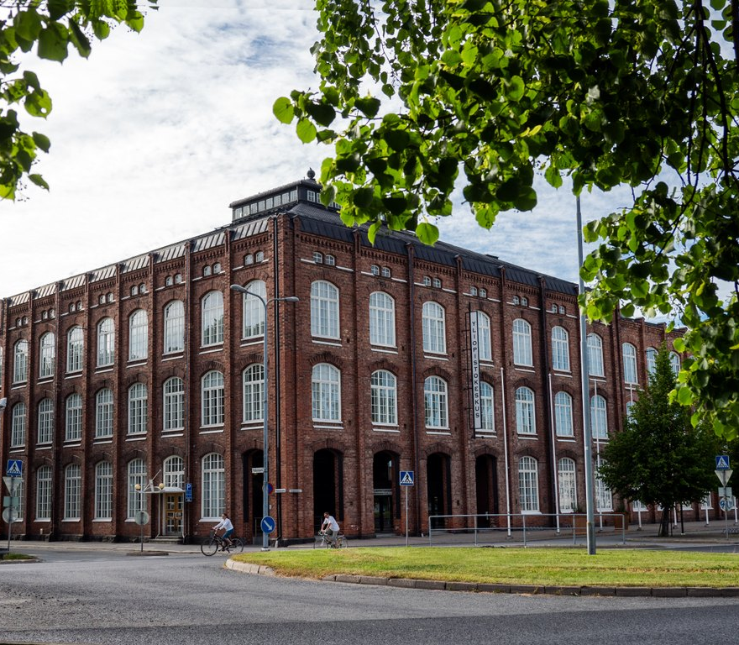
Bachelor’s & Master’s degree programmes
Cultural Production and Landscape Studies
Economics and Business Administration
Social Sciences
Social Work
Master’s degree programmes
Management and Information Technology
Work, Welfare and Well-being
In addition, there are possibilities for doctoral studies.
University Consortium of Pori/ Veera Korhonen
Notes:
https://ucpori.fi/en-gb/university-consortium-of-pori/universities-in-pori/81/

Slide 15
The Educational Health Center in Pori
1
THE FIRST health center designed for teaching and research in the Nordic countries
The University Consortium of Pori has an educational health center which is administered by the Faculty of Medicine of the University of Turku. The health center provides research-based teaching to medical students. Forms of study include practicing work with actual patients and performing small procedures.
Notes:
https://www.ucpori.fi/porin_opetusterveyskeskus
https://www.utu.fi/fi/yliopisto/laaketieteellinen-tiedekunta/porin-opetusterveyskeskus

Slide 16
Rauma Campus of University of Turku
The Department of Teacher Education and the Centre for Maritime Studies of the University of Turku are located in Rauma.
The Faculty of Education offers various degree programmes in Finnish. Additionally, the Master’s degree programme in Education and Learning is in English.
Notes:
https://www.utu.fi/en/university/rauma-campus

Slide 17
Diaconia University of Applied Sciences / Meeri Utti
Diaconia University of Applied Sciences Diak
Diak is Finland’s largest provider of UAS-level education in social work. Diak offers programmes in the following fields:
social work
health care
diaconal work
interpretation
500 students in Pori
Notes:
https://www.diak.fi/en/
https://www.diak.fi/en/diak/organisation/
https://www.diak.fi/en/diak/campuses/pori/

Slide 18
Pori Brigade
The Pori Brigade trains one of the special forces of the Finnish Army: the Finnish Rapid Deployment Force.
2 locations
4000 conscripts
1000 peacekeepers trained each year
Notes:
https://maavoimat.fi/en/pori-brigade
https://intti.fi/en/finnish-rapid-deployment-force

